Slide 1
AWS load balancer

Slide 2
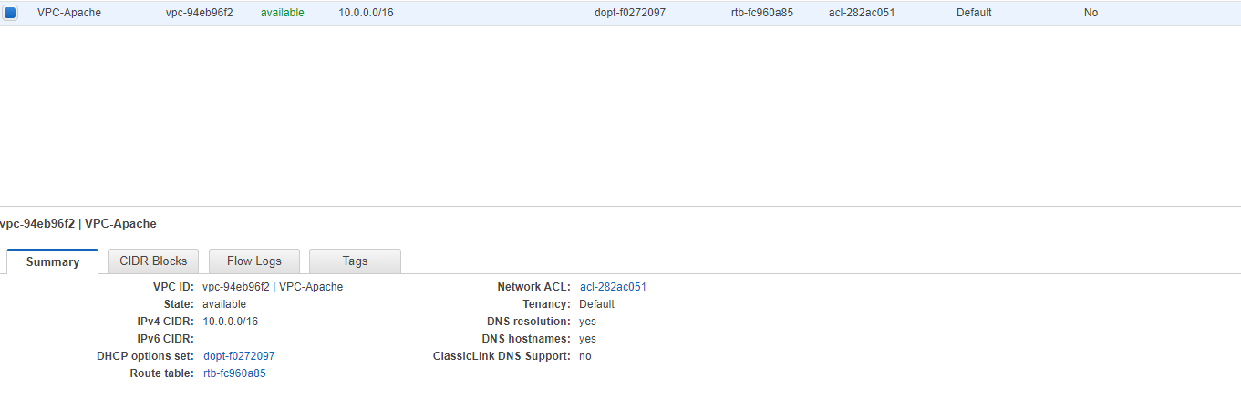
Create vpc

Slide 3
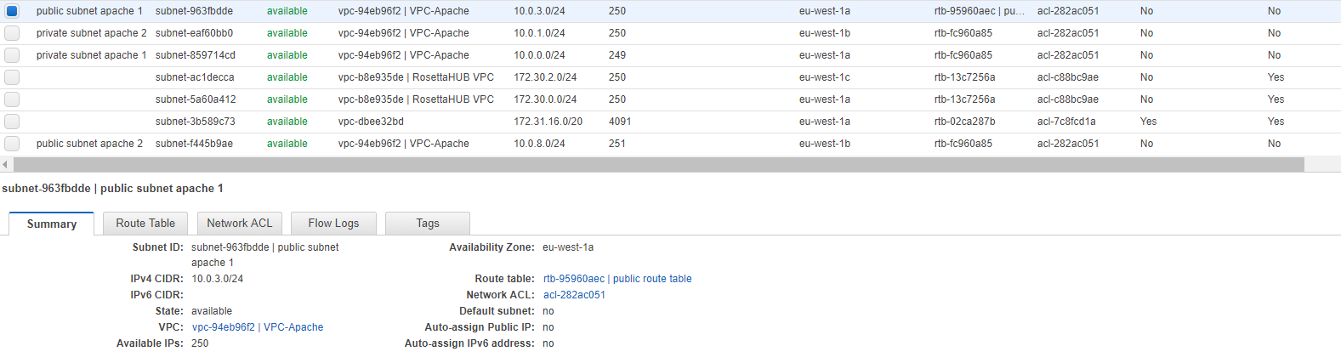
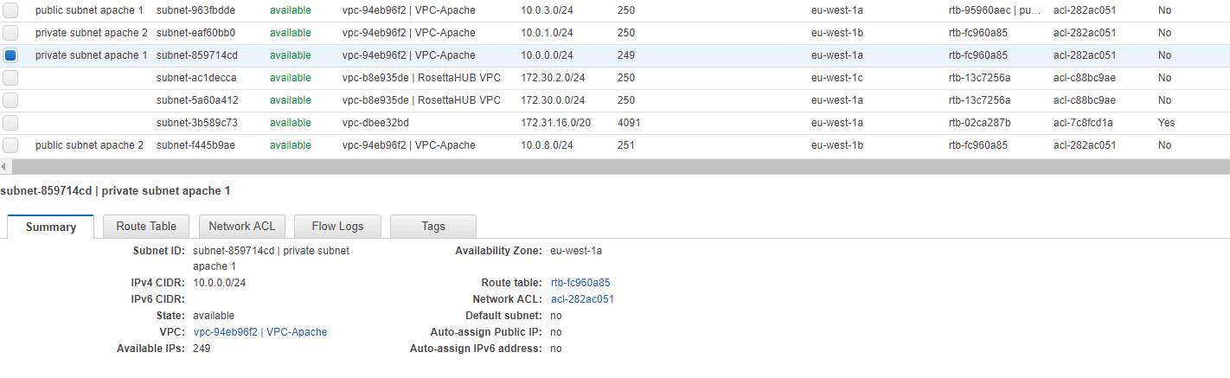
Create public and private subnets in AZ eu-west1a

Slide 4
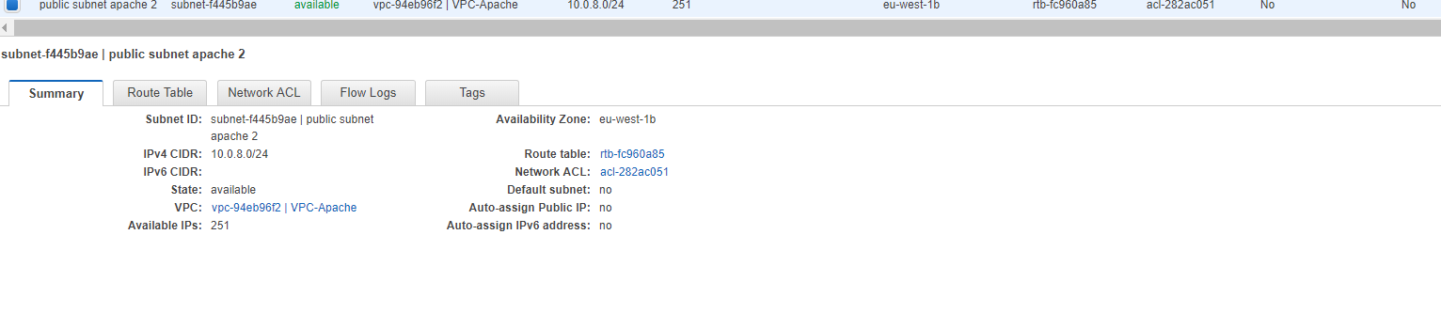
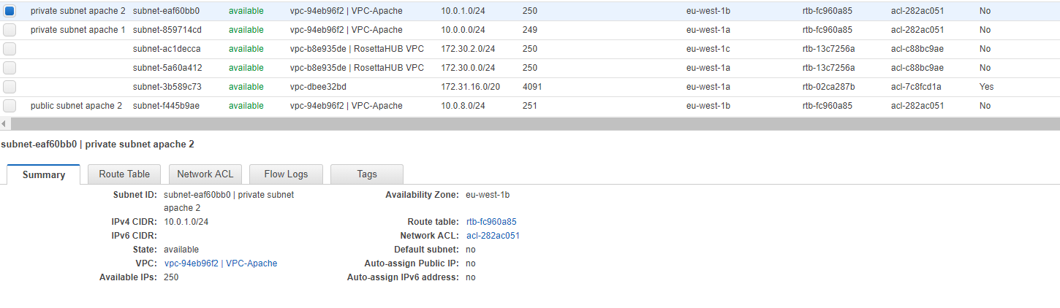
Create public and private subnets in AZ eu-west1b

Slide 5
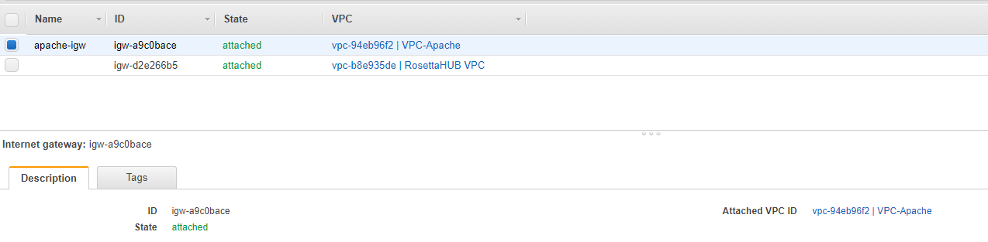
Create Internet Gateway

Slide 6
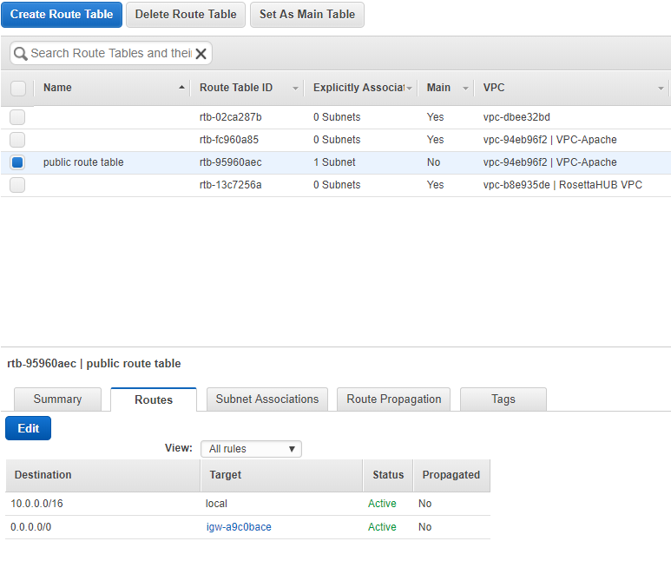
Create route table and associate it to public subnet

Slide 7
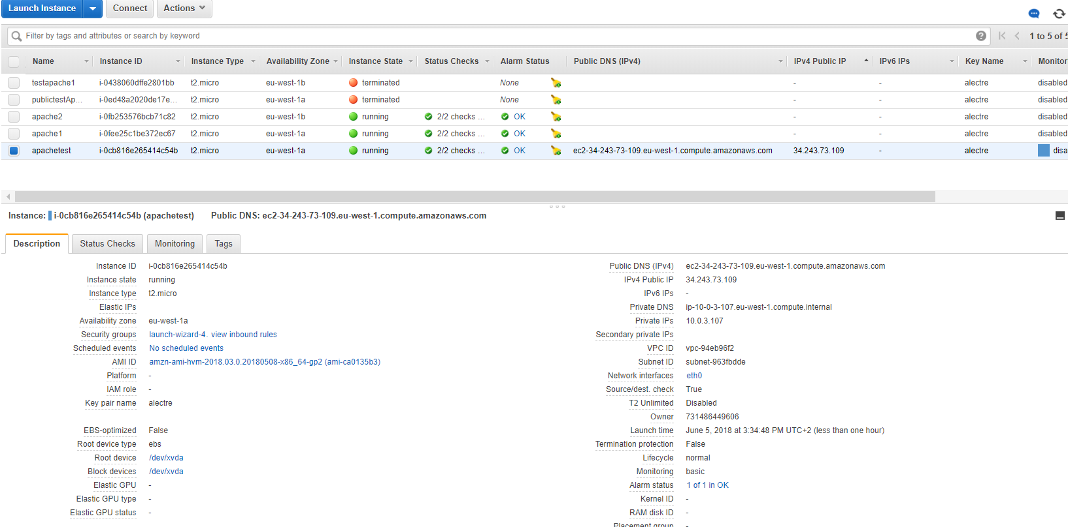
Testing user data script to install Apache server on a public instance
Create public instance with public IP
Modify security group to access it from HTTP (port 80)
In user Data, while creating instance, copy paste the script:
#!/bin/bash
sudo yum update -y
sudo yum -y install httpd
sudo service httpd start
sudo bash -c 'echo Goodbye > /var/www/html/index.html'

Slide 8
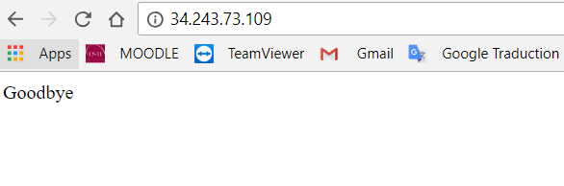
Test with one public instance
First test with google chrome. Not working
Second test with Putty: connection is OK but Apache Server not installed. It’s like the user data script is not working.
By typing the script in the unix environnement, it finally install Apache.
Last try on Chrome:

Slide 9
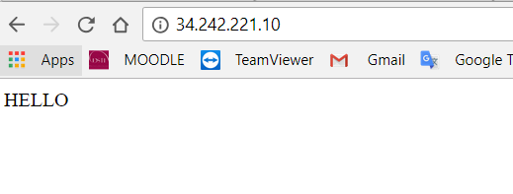
Creating another public instance
Second instance is created, and the Apache server install worked at launch. First try with Chrome is OK

Slide 10
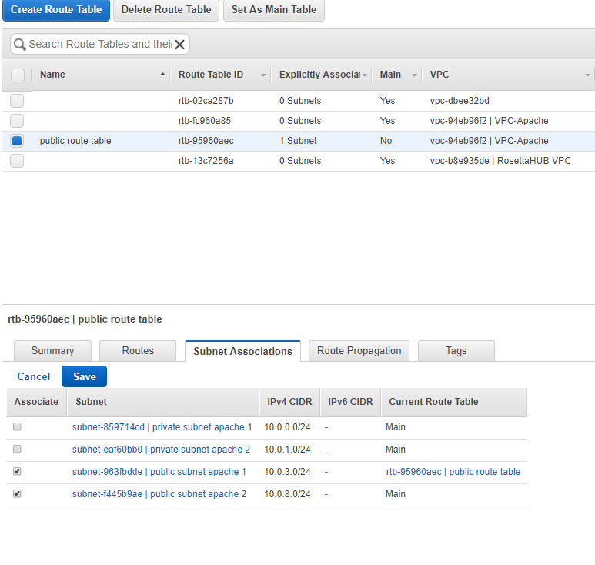
Associating public subnet to route table

Slide 11
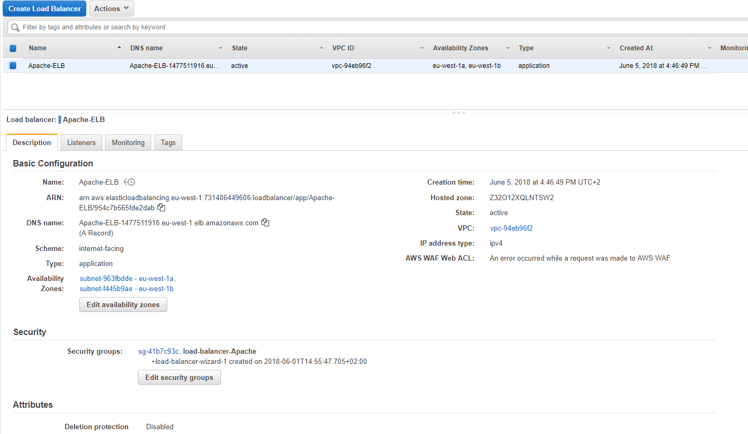
Creating the Elastic Load Balancer

Slide 12
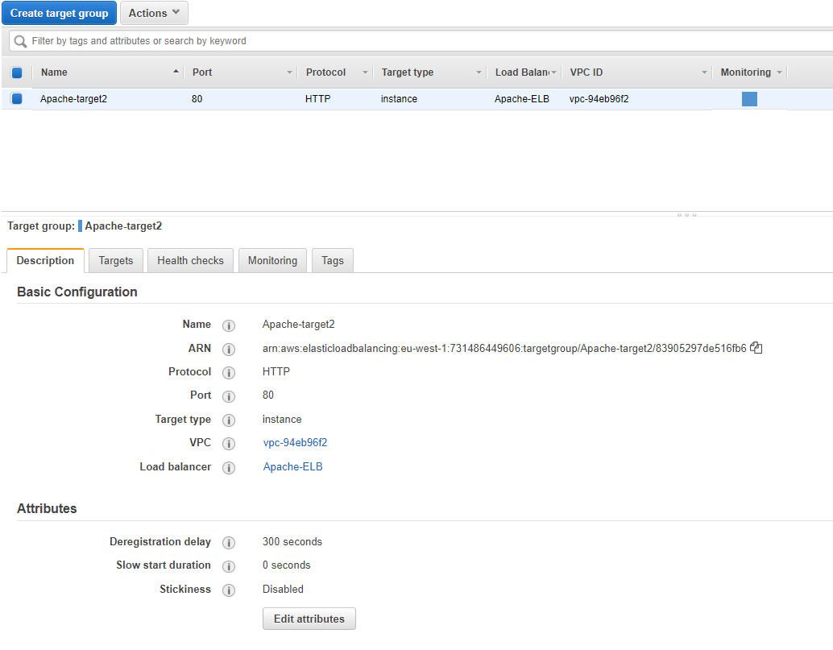
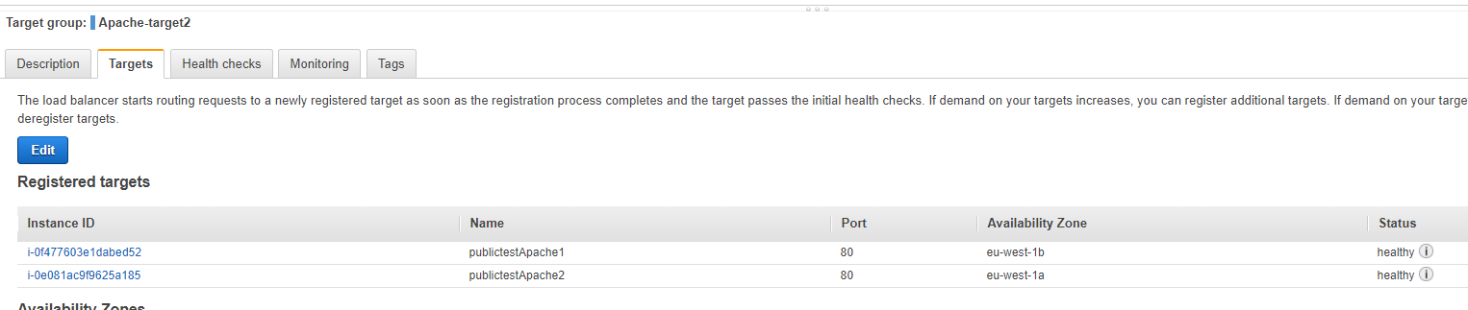
Target for the Elastic Load Balancer

Slide 13
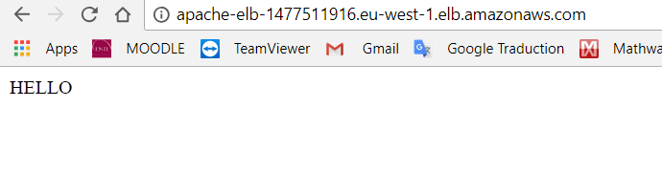
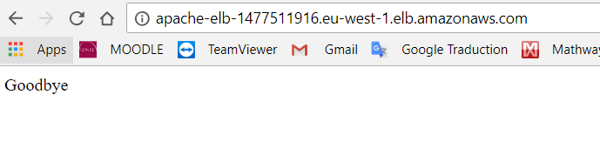
Testing ELB is working
Copy paste DNS name of ELB in Chrome and refresh several times, to see the ELB switching sometimes from an instance (AZ) to another

